Slide 1
This slide is hidden.
Insert the starting slides after this slide

Slide 2


Welcome to St Michael’s
33rd Sunday of Ordinary Time Year A
You have entered a SACRED SPACE
– a SACRED TIME...
Please ensure all mobile phones are switched off.
Please be respectfully quiet
as we prepare for our celebration.
Notes:
Saturday 5.30PM First Sunday of Advent
23rd Sunday in Ord Time
23rd Sunday in Ord Time

Slide 3
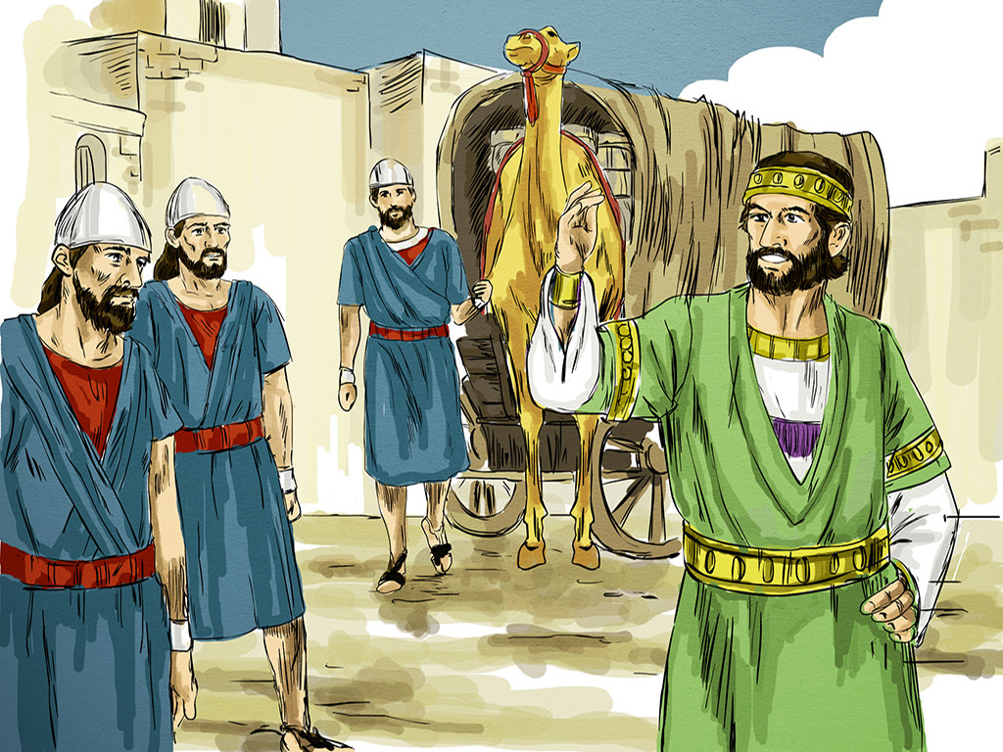
Jesus spoke this parable to his disciples:
'The kingdom of heaven is like a man on his way abroad who summoned his servants …’
Notes:
7am - 14th Sunday in Ord Time
7am - 14th Sunday in Ord Time

Slide 4
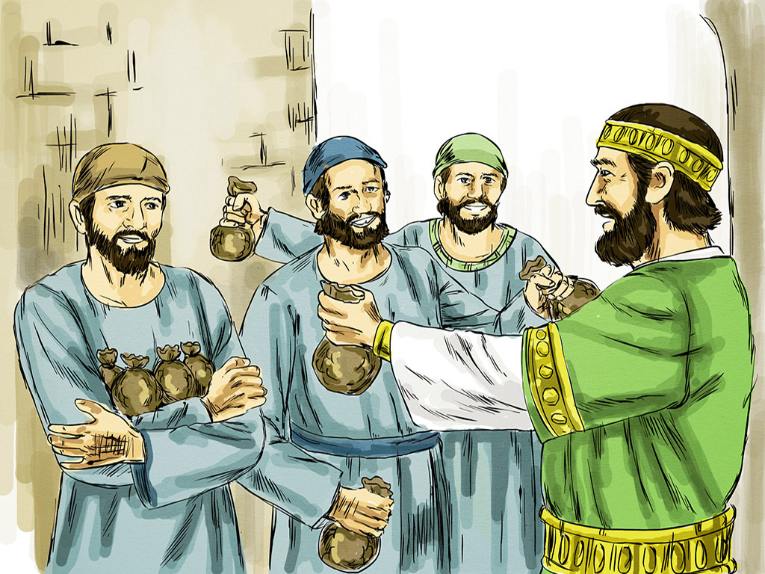
To one servant he gave five talents,
to another two, to a third one;
each in proportion to his ability…

Slide 5
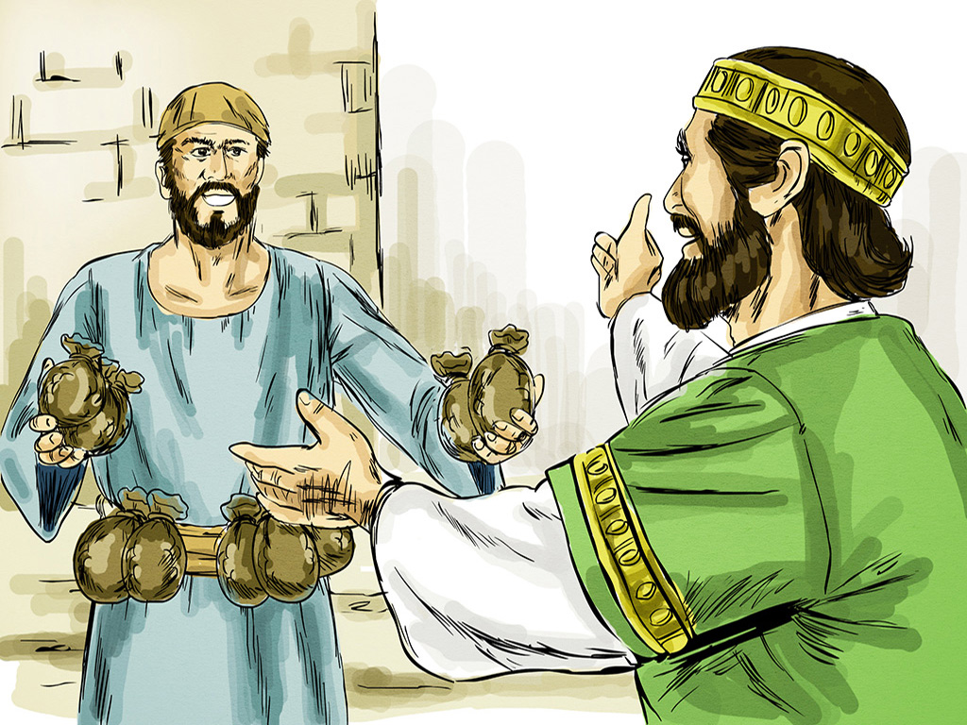
The servant who had received the five talents came forward bringing five more.
The master replied, “Well done, good and faithful servant”
Notes:
7am - 14th Sunday in Ord Time
7am - 14th Sunday in Ord Time

Slide 6
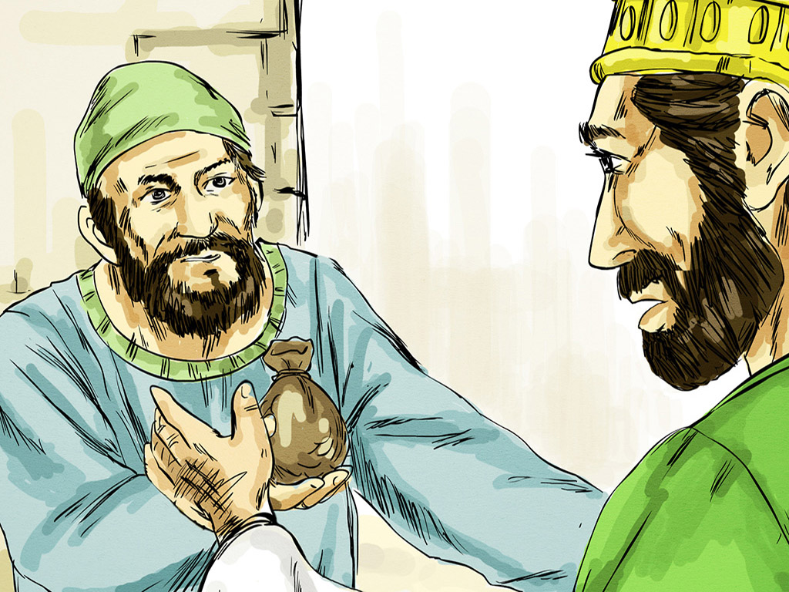
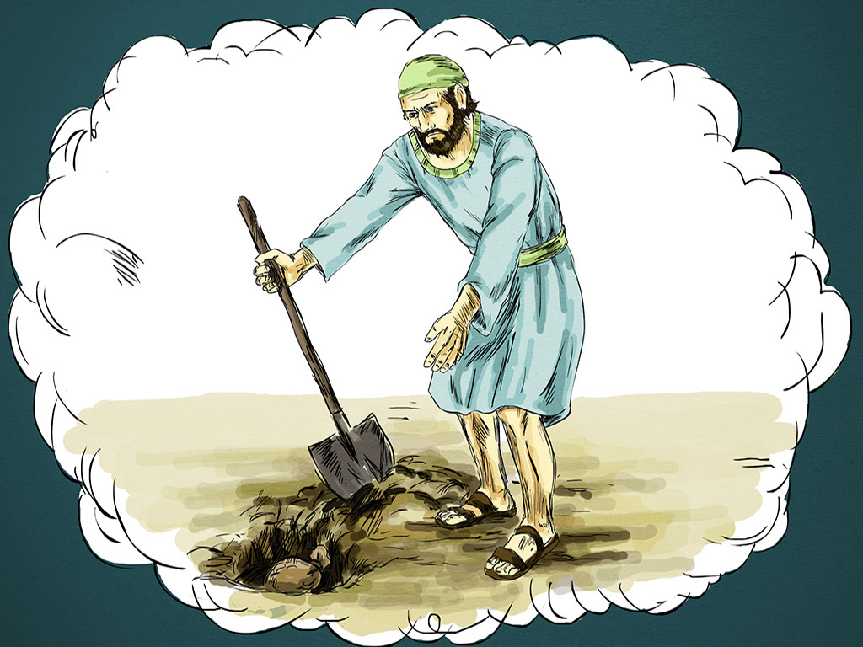
I was afraid, and I went off and hid your talent in the ground. Here it is; it was yours, you have it back." But his master answered him, "You wicked and lazy servant!
Notes:
7am - 14th Sunday in Ord Time
7am - 14th Sunday in Ord Time

Slide 7
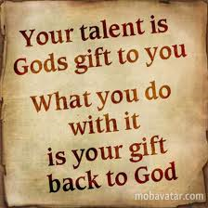
What do I do with the talents/gifts which God has given me?
Notes:
7am - 14th Sunday in Ord Time
7am - 14th Sunday in Ord Time

Slide 8
Please Stand

Slide 9
This slide is hidden.
Insert the Entrance Hymn after this slide

Slide 10
Praise the name of Jesus
Praise the name of Jesus
Praise him as we pray
Praise the name of Jesus
Sing to him all our days

Slide 11
From the rising of the sun
To the setting of the same
The name of the Lord is to be praised
In all things let's praise his name

Slide 12
Praise the name of Jesus
Praise him as we pray
Praise the name of Jesus
Sing ot him all our days

Slide 13
Let us come unto the Lord
Let us make a joyful noise
He has healed us through his word
In all things let's praise his name

Slide 14
Praise the name of Jesus
Praise him as we pray
Praise the name of Jesus
Sing to him all our days
Sing to him all our days

Slide 16
Confiteor
I confess to almighty God
And to you, my brothers and sisters,
That I have greatly sinned
In my thoughts and in my words

Slide 17
In what I have done
And in what I have failed to do,
Through my fault,
Through my fault,
Through my most grievous fault;

Slide 18
Therefore I ask blessed Mary ever-Virgin,
All the Angels and Saints,
And you, my brothers and sisters,
To pray for me to the Lord our God.

Slide 20
Kyrie eleison
Kyrie eleison (2)
Christe eleison (2)
Kyrie eleison (2)

Slide 22
Gloria
Glory to God in the highest,
and on earth peace to people of good will.
We praise you, we bless you,
we adore you, we glorify you,

Slide 23
We give you thanks for your great glory,
Lord, God heavenly king,
O God, almighty father

Slide 24
Glory to God in the highest,
and on earth peace to people of good will.

Slide 25
Lord Jesus Christ, Only Begotten Son,
Lord God, Lamb of God, Son of the Father,
you take away the sins of the world,
have mercy on us;

Slide 26
you take away the sins of the world, receive our prayer;
you are seated at the right hand of the Father,
have mercy on us.

Slide 27
Glory to God in the highest,
and on earth peace to people of good will.

Slide 28
For you alone are the Holy One,
you alone are the Lord,
you alone are the Most High, Jesus Christ,
with the Holy Spirit,
in the glory of God the Father.

Slide 29
Glory to God in the highest,
and on earth peace to people of good will.
Amen.

Slide 31
Responsorial Psalm
Happy are those who fear the Lord

Slide 33
Alleluia
Alleluia, alleluia,
alleluia, alleluia

Slide 35
Apostles Creed
I believe in God,
the Father almighty,
Creator of heaven and earth,
and in Jesus Christ, his only Son, our Lord,
(At the words that follow, up to and including the Virgin Mary, all bow.)

Slide 36
who was conceived by the Holy Spirit,
born of the Virgin Mary,
suffered under Pontius Pilate,
was crucified, died and was buried;
he descended into hell;

Slide 37
on the third day he rose again from the dead;
he ascended into heaven,
and is seated at the right hand of God the Father almighty;

Slide 38
from there he will come to judge the living and the dead.
I believe in the Holy Spirit,
the holy catholic Church,

Slide 39
the communion of saints,
the forgiveness of sins,
the resurrection of the body,
and life everlasting.
Amen.

Slide 41
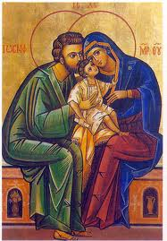
Jesus, Mary and Joseph,
in you we contemplate
the splendor of true love,
to you we turn with trust.
Holy Family of Nazareth,
grant that our families too
may be places of communion and prayer,
authentic schools of the Gospel
and small domestic Churches.

Slide 42
Holy Family of Nazareth, may families never again
experience violence, rejection and division:
may all who have been hurt or scandalized
find ready comfort and healing.
Holy Family of Nazareth, may the Synod of Bishops on the Family make us once more mindful of the sacredness of the family, and its beauty in God's plan.
Mary, Queen of the Family - Pray for us

Slide 43
First Collection
This collection goes to the Bishop
for the support of the Diocese.
Thank you for your contribution

Slide 45
This slide is hidden.
Insert the Offertory Hymn after this slide.

Slide 46
Blessed be God
Blest are you Lord, God of all creation
Thanks to your goodness
This bread we offer
Fruit of the earth, work of our hands
It will become the bread of life

Slide 47
Blessed be God, blessed be God
Blessed be God forever, amen
Blessed be God, blessed be God
Blessed be God forever, amen

Slide 48
Blest are you Lord God or all creation
Thanks to your goodness
This wine we offer
Fruit of the vine, work of our hands
It will become the cup of joy

Slide 49
Blessed be God, blessed be God
Blessed be God forever, amen
Blessed be God, blessed be God
Blessed be God forever, amen

Slide 51
Priest: Pray my brothers and sisters,
that my sacrifice and yours may be
acceptable to God, the almighty Father.
All: May the Lord accept the sacrifice
at your hands for the praise and glory of his name, for our good and the good of all his holy Church.

Slide 52
Priest: The Lord be with you.
All: And with your spirit.
Priest: Lift up your hearts.
All: We lift them up to the Lord.

Slide 53
Priest: Let us give thanks to the
Lord our God.
All: It is right and just.

Slide 55
Holy
Holy, Holy, Holy Lord God of hosts,
Heaven and earth are full of your glory. Hosanna in the highest
Blessed is he who comes
in the name of Lord,
Hosanna in the highest.

Slide 57
Memorial acclamation
Save us saviour of the world,
For by your cross and resurrection,
You have set us free

Slide 58
Memorial acclamation
When we eat this bread
And drink this cup
We proclaim your death O Lord
Until you come again

Slide 59
Memorial acclamation
We proclaim your death O Lord
And profess your resurrection
Until you come again

Slide 61
Amen
Amen, amen, amen, amen.
Amen, amen, amen, amen.

Slide 63
Priest: The Lord be with you.
All: And with your spirit

Slide 65
Peace
May the peace of the Lord be with you
With your friends and your family too
Let it be, let it grow
And everywhere you go
May the peace of the Lord follow you

Slide 66
Lamb of God
Lamb of God, lamb of God
You take away the sins of the world
Have mercy on us, lamb of God

Slide 67
Lamb of God, lamb of God
You take away the sins of the world
Have mercy on us, lamb of God

Slide 68
Lamb of God, lamb of God
You take away the sins of the world
Grant us, grant us peace

Slide 70
Priest: Behold the Lamb of God, behold him
who takes away the sins of the world.
Blessed are those called to the supper of the Lamb.
All: Lord, I am not worthy
that you should enter under my roof,
but only say the word
and my soul shall be healed.

Slide 71
This slide is hidden.
Insert the Communion Hymns after this slide.

Slide 72
In love for me
This is my body broken for you
Bringing you wholeness making you free
Take it and eat it, and when you do
Do it in love for me

Slide 73
This is my blood poured out for you
Bringing forgiveness, making you free
Take it and drink it, and when you do
Do it in love for me

Slide 74
This is my body broken for you
Bringing you wholeness making you free
Take it and eat it, and when you do
Do it in love for me

Slide 75
This is my blood poured out for you
Bringing forgiveness, making you free
Take it and drink it, and when you do
Do it in love for me
Do it in love for me

Slide 76
I am the bread of life
I am the bread of life,
He who comes to me shall not hunger,
He who believes in me shall not thirst.
No one can come to me
Unless the Father draw him.

Slide 77
And I will raise him up,
And I will raise him up,
And I will raise him up on the last day.

Slide 78
The bread that I will give
Is my flesh for the life of the world,
And he who eats of this bread,
He shall live for ever,
He shall live for ever.

Slide 79
And I will raise him up,
And I will raise him up,
And I will raise him up on the last day.

Slide 80
Unless you eat of the flesh
Of the Son of Man,
And drink of His blood
And drink of His blood,
You shall not have life within you

Slide 81
And I will raise him up,
And I will raise him up,
And I will raise him up on the last day.

Slide 82
And I will raise him up,
And I will raise him up,
And I will raise him up on the last day.

Slide 83
Make me like you
Lord make me like you
Please make me like you
You are a servant
Make me one too

Slide 84
O Lord I am willing
Do what you must do
To make me like you, Lord
Please make me like you

Slide 85
Lord make me like you
Please make me like you
You are a servant
Make me one too

Slide 86
O Lord I am willing
Do what you must do
To make me like you, Lord
Please make me like you

Slide 87
Whatever you do, Lord
Please make me like you

Slide 89
Second Collection
What you contribute now
is for the support of our
parish and its mission.
Thank you for your generosity

Slide 90
This slide is hidden.
Insert the Notices for the week after this slide

Slide 91
MINISTRY AFTERNOON
Are you involved in Ministry in our Parish???
MINISTRY REFLECTION
AND
THANKYOU AFTERNOON TEA
SUNDAY 23 NOVEMBER 2014
2.00PM
NAGLE COLLEGE HALL

Slide 92


Friday
21 November
MEET CHRIST:
BETWEEN ‘THE PUB AND THE PEW’
St Michael’s Church Centre 7pm

Slide 93

COST $10.00
pick up your copy from the Sacristy.

Slide 94

VINNIES GIVING TREE
Please take a tag off the tree to provide gifts and/or food for the Vinnies Christmas Hampers. Return by Sunday 7 December.
Many thanks
St Vincent De Paul Society

Slide 95

Please take home your bulletin or download it
www.stmichaelsparish.com
www.facebook.com/blacktowncatholics

Slide 96
This slide is hidden.
The next slide can be used for videos.
Insert the video into the slide.

Slide 98
Priest: The Lord be with you.
All: And with your spirit.

Slide 100
This slide is hidden.
Insert the Recessional Hymns after this slide.

Slide 101
I have decided
I have decided to follow Jesus
I have decided to follow Jesus
I have decided to follow Jesus
No turning back
No turning back

Slide 102
The world behind me, the cross before me
The world behind me, the cross before me
The world behind me, the cross before me
No turning back
No turning back

Slide 103
Though none go with me, still I will follow
Though none go with me, still I will follow
Though none go with me, still I will follow
No turning back
No turning back

Slide 104
This slide is hidden.
Insert the final slide here.

